Slide 1

Advanced SQL-IMDB Dataset
Name : SHAHIN SULAIMAN M
DATE: 21.01.2025

Slide 2
DATASET OVERVIEW
1.Movie: Contains basic information about each movie, including title, release year, duration, country, income, languages, and production companies.
2. Genre: Describes the genres associated with each movie.
3. Director Mapping: Maps movies to their directors.
4. Role Mapping: Maps actors/actresses to movies and specifies the role category (e.g., actor, director, producer).
5. Names: Stores information about people (actors, directors, etc.), including their birthdates, heights, and known movies.
6. Ratings: Contains ratings information for movies, including the average rating, total votes, and median rating.

Slide 3
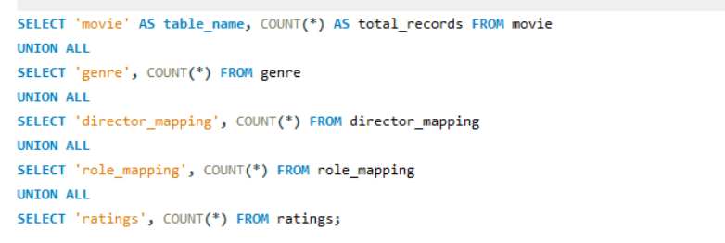
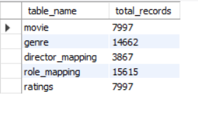
1.Count the total number of records in each table of the database.

Slide 4
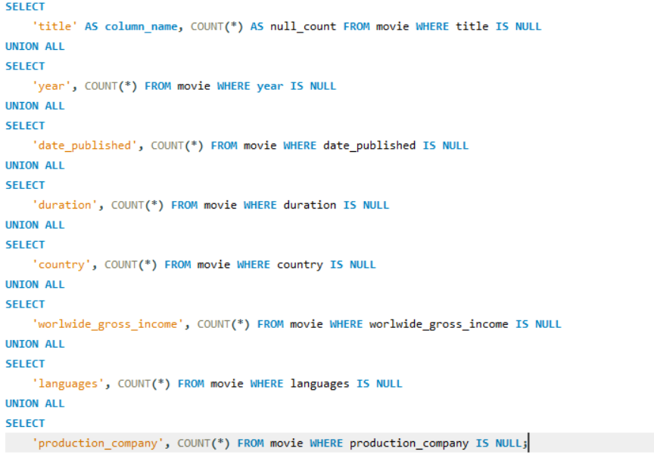
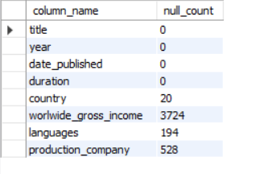
2.Identify which columns in the movie table contain null values.

Slide 5
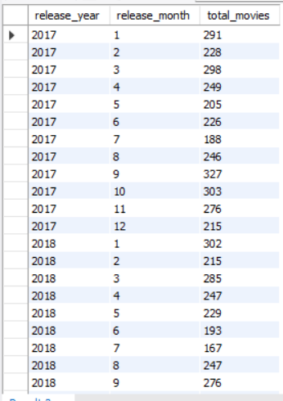
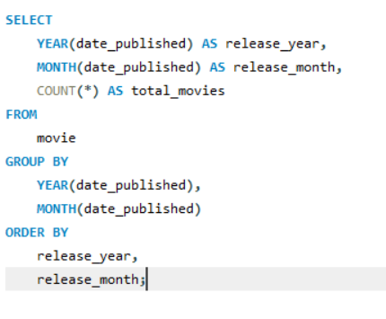
3.Determine the total number of movies released each year, and analyze how the trend changes month-wise.

Slide 6

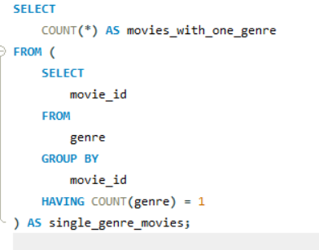
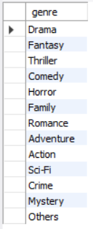

4.List the unique genres in the dataset, and count how many movies belong exclusively to one genre.

Slide 7
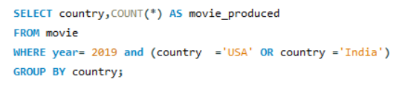
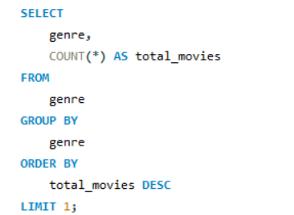


5.How many movies were produced in either the USA or India in the year 2019? 6.Which genre has the highest total number of movies produced?

Slide 8
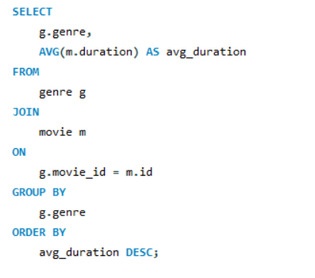
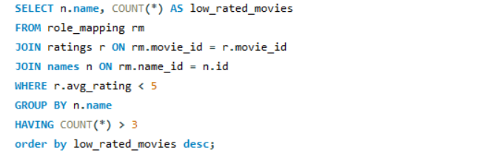
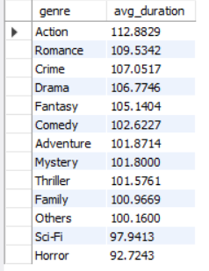
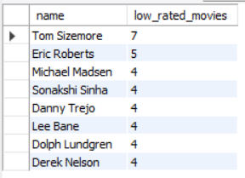
7.Calculate the average movie duration for each genre. 8.Actors or actresses who have appeared in more than three movies with an average rating below 5.

Slide 9





9.Find the minimum and maximum values for each column in the ratings table, excluding the movie_id column.

Slide 10
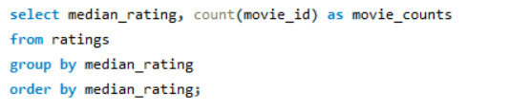
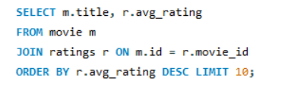
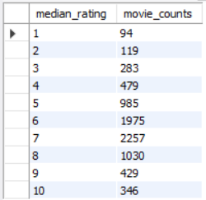
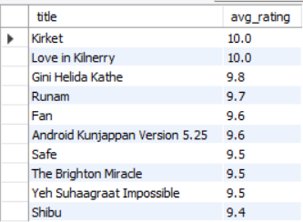
10.Which are the top 10 movies based on their average rating? 11.Summarize the ratings table by grouping movies based on their median ratings

Slide 11
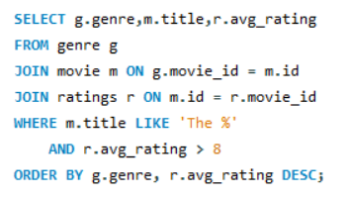
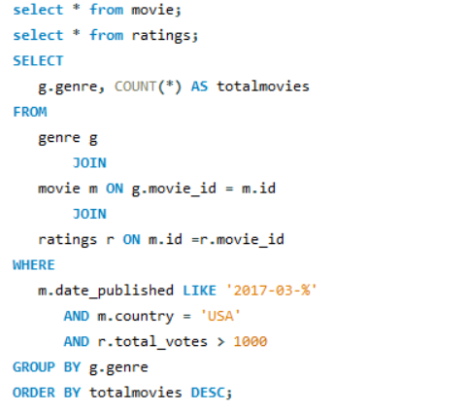
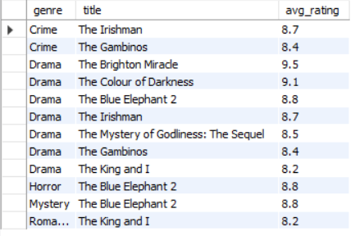
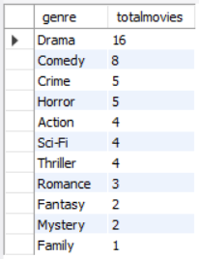
12.How many movies, released in March 2017 in the USA within a 13.Find movies from each genre that begin with the word “The” and have an a average rating greater than 8. specific genre, had more than 1,000 votes?

Slide 12
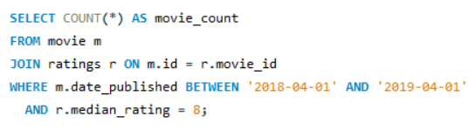
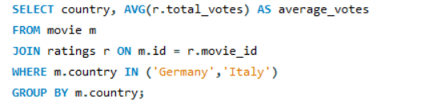


14. Of the movies released between April 1, 2018, and 15.Do German movies receive more votes on average than Italian movies? April 1, 2019, how many received a median rating of 8?

Slide 13
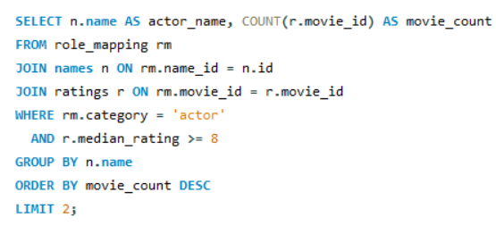
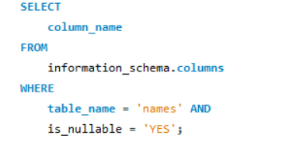
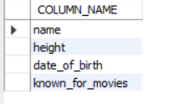

16.Identify the columns in the names table 17. Who are the top two actors whose movies have a median rating of 8 or higher? that contain null values.

Slide 14
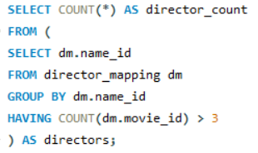
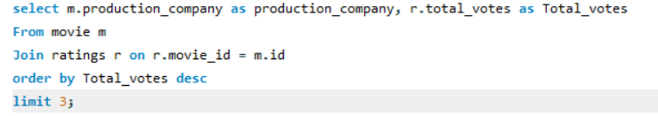


18.Which are the top three production companies based 19.How many directors have worked on more than three movies? on the total number of votes their movies received?

Slide 15
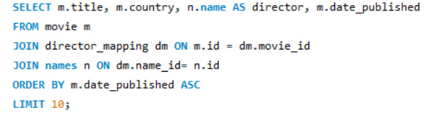
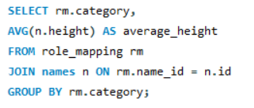
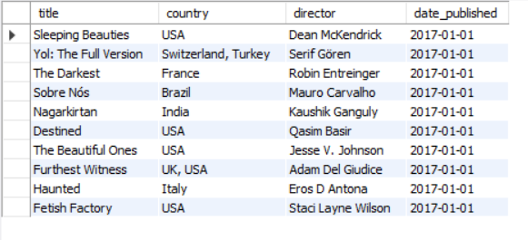

21.List the 10 oldest movies in the dataset along with 20.Calculate the average height of actors and actresses their title, country, and director. separately.

Slide 16
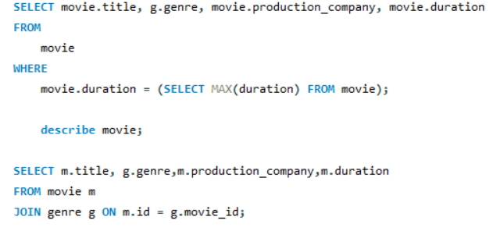
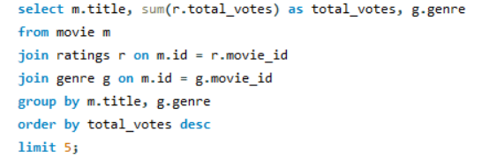
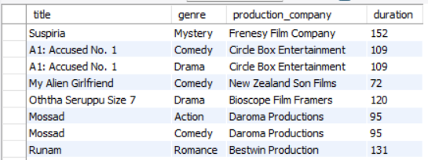
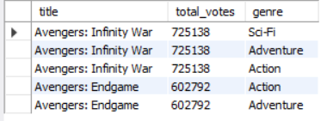
22.List the top 5 movies with the highest total votes,along with their genres 23.Identify the movie with the longest duration, along with genre and production company.

Slide 17
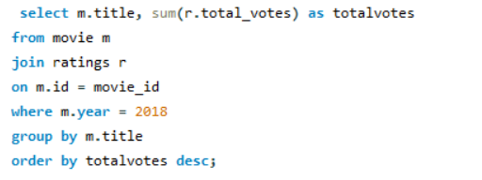
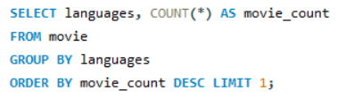

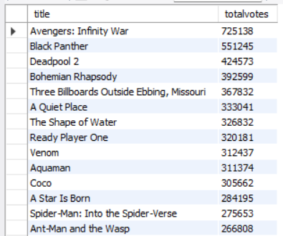
24.Determine the total number of votes for 25.What is the most common language in which movies were produced? each movie released in 2018.

Slide 18
Key Findings for IMDb Dataset
Movies with the Longest Duration
Top Genres by Popularity
Movies with High Ratings
Movies in Specific Countries
Voting Patterns and Audience Engagement
Actor and Genre Performance
Median Ratings Analysis

Slide 19
Conclusion and Insights
Genre-Specific Strategy:
Studios can prioritize high-performing genres to maximize reach and profitability.
Actor-Driven Performance:
Associating with high-rated actors like actor could positively impact ratings and box office performance.
Seasonal Planning:
Leveraging peak production/release periods (e.g., summer or holiday seasons) can enhance audience turnout.
Focus on Quality:
Median ratings highlight audience preference for quality content, urging studios to prioritize compelling narratives over quantity.

Slide 20


